Slide 1
Moose project temperature profiles of steady state and transient heat conduction
Student: Vedant U. Deshpande
Mentor: Dr. B. beeler
Subject: Nuclear Fuel Performance

Slide 2
Index
Introduction
Heat Transport
Dimensions
Steady State Heat Conduction ( Input file)
Output of steady state ( Temperature profile and graph for distribution along radius)
Transient Heat Conduction (Input file)
Temperature profile for transient heat conduction and point 1
Graph of temperature distribution along radius for point 1
Graph of temperature distribution along time for point 1
Point 2
Graph of temperature distribution along time for point 2
Conclusion

Slide 3
Introduction
Fuel core has three distinct parts: Fuel, Gap between fuel and cladding, Cladding.
Heat generated through fission is transported through fuel, gap and clad to coolant for further process.
Temperature distribution and profile is necessary to study and monitor to see whether heat transfer is occurring the way it should be.
There are many software that one can use to monitor temperature profile, but for this project we have used MOOSE which is software from INL.
Moose is also available on clusters, so we can work on project even without having moose on computer through software like putty.

Slide 4
Heat Transport
Heat transfer occurs through fuel and cladding by heat conduction.
Heat transfer through gap between fuel and cladding happens by conduction and some convection. In this project we are considering only conduction.
It can be seen in two different types: Steady state heat transport where heat transfer rate is constant regardless of time interval and non-steady state or Transient heat transport where heat transfer rate changes with respect to position but mainly time, defined by specified equations.
Moose uses ‘heat_conduction_time_derivative’ kernel for transient heat transport.
Here, we specify start time and time step, so simulation is run according to that.
In steady state in materials sections, only thermal conductivity is specified. In transient, thermal conductivity, specific heat capacity and density is needed to be specified.

Slide 5
Dimensions
In this project different dimensions have been specified for both steady state as well as transient heat conduction.
Thermal conductivity: Fuel = 0.3 W/cm-K, Gap = 0.3 W/m-K, Cladding = 0.17 W/cm-K
Mesh: 100 x 100
Outer cladding temperature: 500 K
For, (a) Steady state: volumetric heating rate: Q = 250 W/cm2, (b) For transient heat conduction: volumetric heating rate: Q = 150*(-0.03*time)+250 for up to, t(time) = 200
As problem is multiblock based I have created two more subdomains as ‘fuel+gap’ and ‘fuel.
Symmetry about Y-axis is considered.
Software called ‘Paraview’ was used to get the visual output.

Slide 6
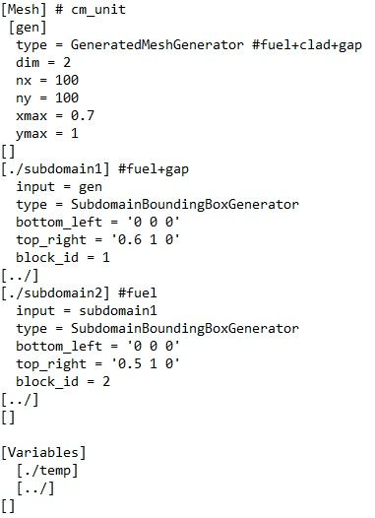
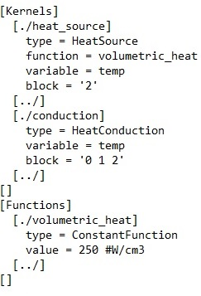
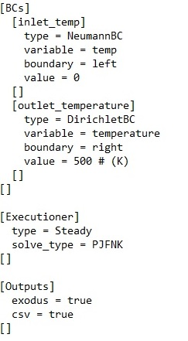

Steady State Heat Conduction
Input file: As different blocks are considered ‘heat_source’ kernel is also used.

Slide 7
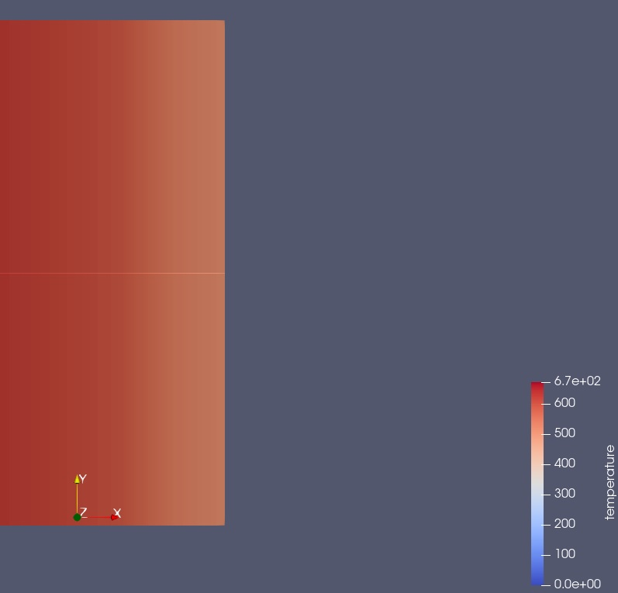
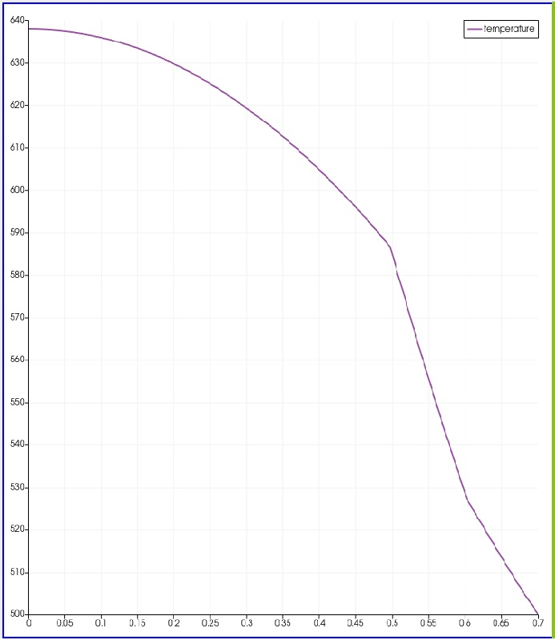
Output of steady state ( Temperature profile and graph for distribution along radius)

Slide 8
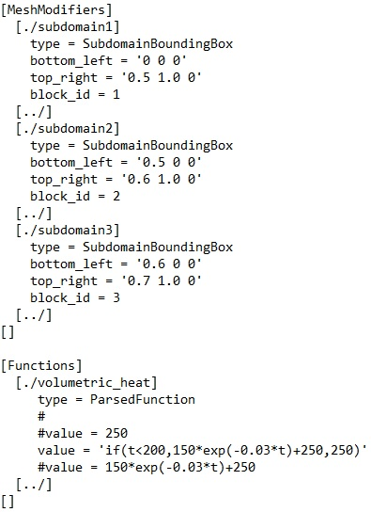
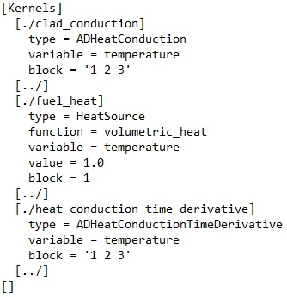
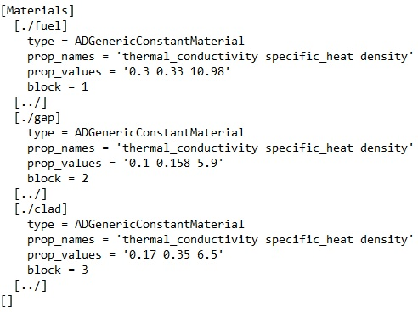
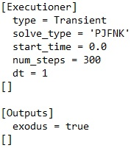
Transient Heat Conduction
Input file:

Slide 9
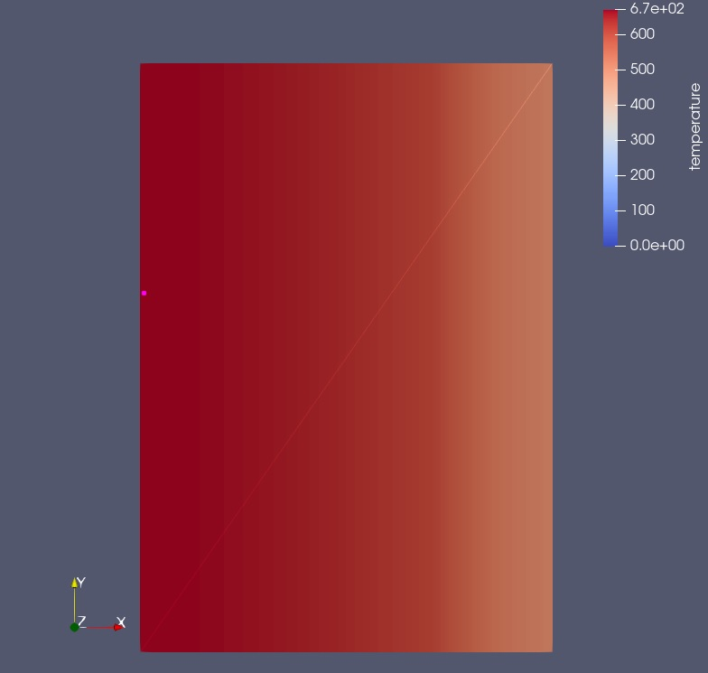
Temperature profile for transient heat conduction and point 1
For transient, one point has to be selected to see ‘temperature distribution’ as per time as well as position.
Two point’s were considered for this one, left and one is middle.
Picture at side is point 1 selected on temperature profile after 34 runs.
For point 1, graph of temperature distribution along time and radius was obtained in paraview.

Slide 10
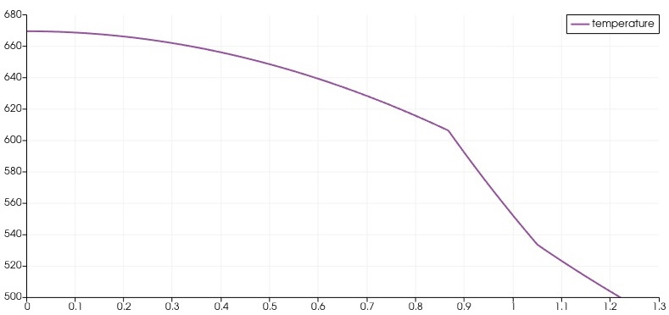
Graph of temperature distribution along radius for point 1

Slide 11
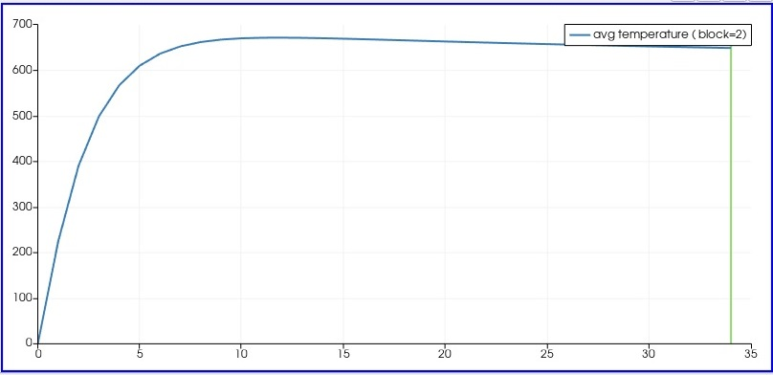
Graph of temperature distribution along time for point 1

Slide 12
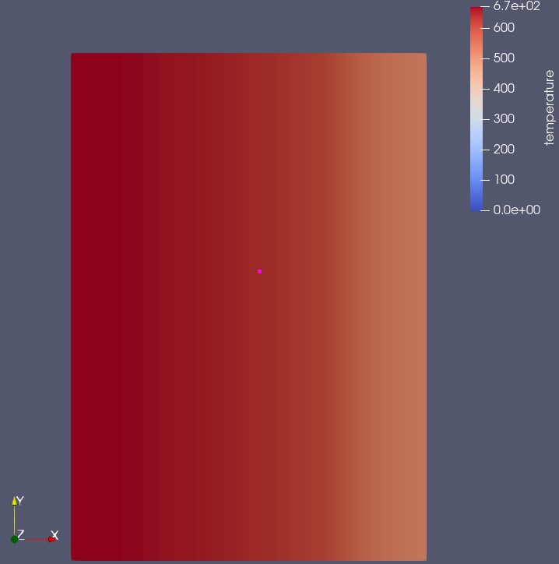
Point 2
Picture at side is point 1 selected on temperature profile after 34 runs.
For point 2, graph of temperature distribution along time was obtained.

Slide 13
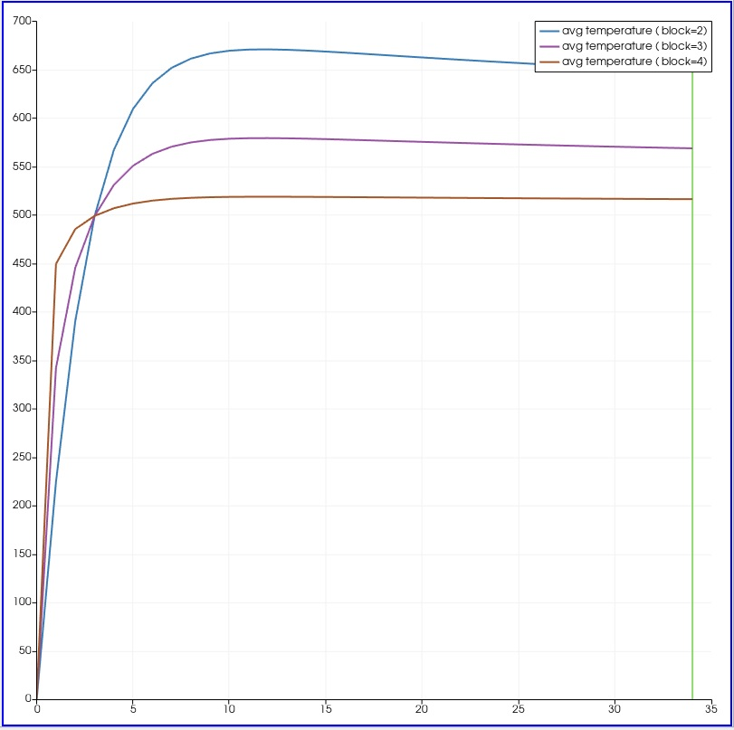
Graph of temperature distribution along time for point 2

Slide 14
Conclusion
Moose is very useful software for doing various Multiphysics calculations.
Distribution of temperature along radius for steady state heat conduction is very easily and quite efficiently seen because of moose. We can have analytical calculations, which will be almost same for moose based result seen in paraview.
Distribution of Temperature along time for un-steady state or transient heat conduction can also be seen quite efficiently, given that all parameters are specified with precision in moose program.
Pattern of temperature distribution for transient heat conduction at certain specific point and after certain specific run is similar is steady state were to be considered at that point.

